Slide 1


CP-ITI-1297: Incorporate HL7 Gender Harmony Transaction Updates into ITI transactions
IT Infrastructure (ITI) Domain

Slide 2
CP-ITI-1297
Overview
IHE IT Infrastructure (ITI) is adopting the HL7 Gender Harmony model across multiple transactions to enhance representation of gender-related data.
Approach
Follow the HL7 Cross Paradigm Implementation Guide, applying it to IHE ITI profiles where sex and gender data may be exchanged.
FHIR-based profiles (PDQm, PIXm, PMIR):
Add Gender Harmony extensions to the Patient resource profiles.
Optional, but when used, actors SHALL encode them according to HL7 Gender Harmony
HL7v2-based profiles (PDQ, Document Sharing/sourcePatientInfo):
GSP, GSC, and GSR segments are optional, if used, they SHALL be encoded according to HL7 Gender Harmony

Slide 3
Impacted Transactions
Profile | Transaction | Change
PDQ | ITI-21 | Add note on optional GSP/GSR segments.
PDQm | ITI-78, ITI-119 | Add Gender Harmony FHIR extensions to Patient Resource.
PIXm | ITI-83, ITI-104 | Dependency on PDQm Patient + extensions.
PMIR | ITI-93 | Inherits PDQm Patient updates.
XCA/XDS | ITI-18, ITI-41 | Note on optional GSP/GSC segments in sourcePatientInfo.

Slide 4
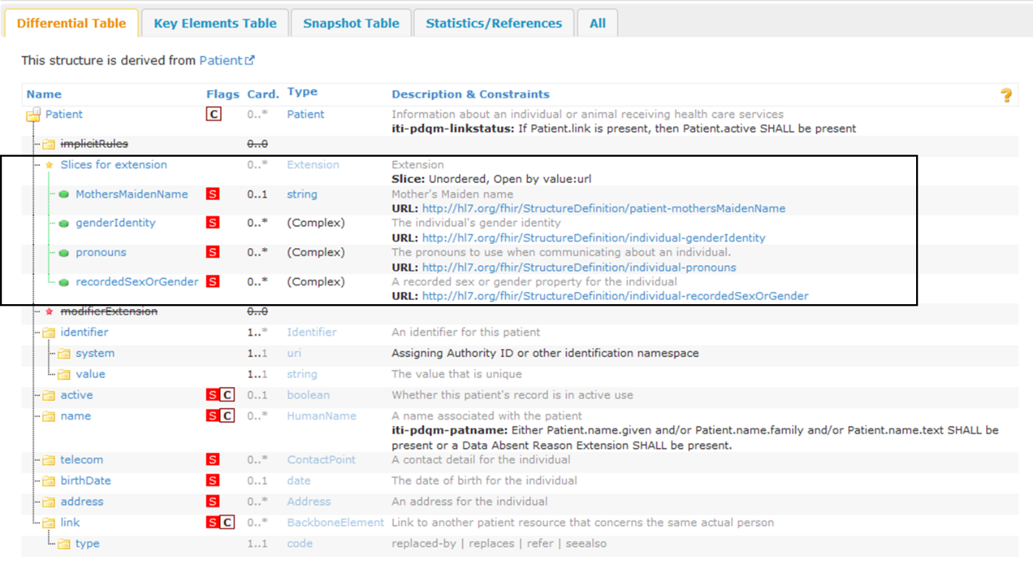
PDQm Patient Profile

Slide 5

IHE ITI CP Ballot 65
https://drive.google.com/drive/folders/1rIU5FMHwUr3alRU6IjJh1QFn2kcPW8ti

